Slide 1
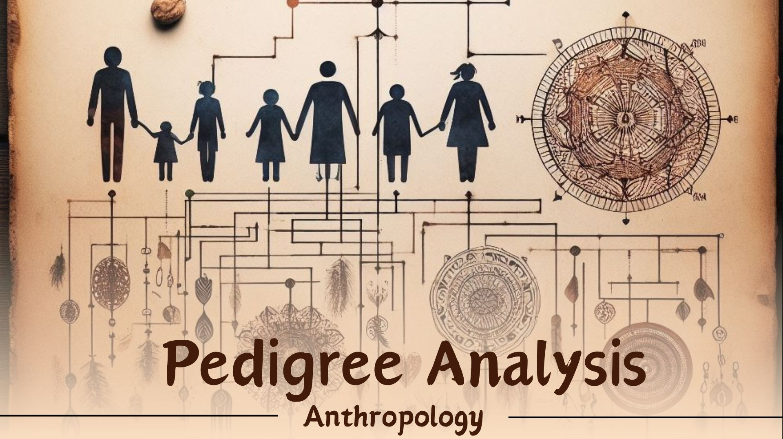

Slide 2
PEDIGREE ANALYSIS
Maedel Joy V. Escote, Ph.D.

Slide 3
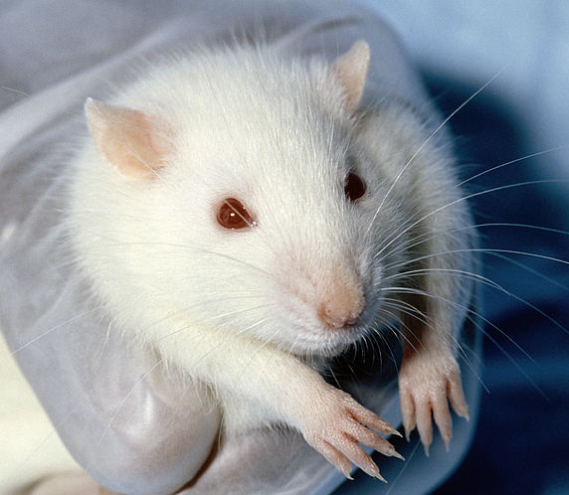
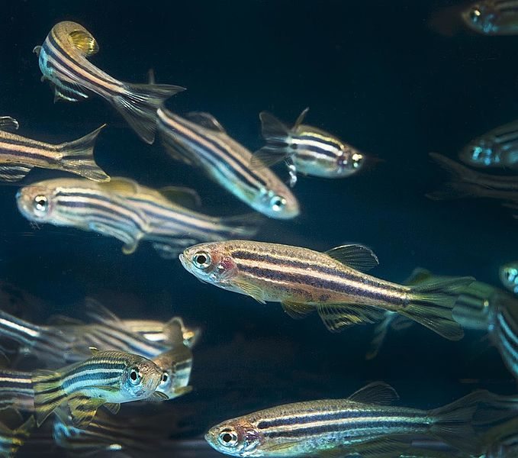
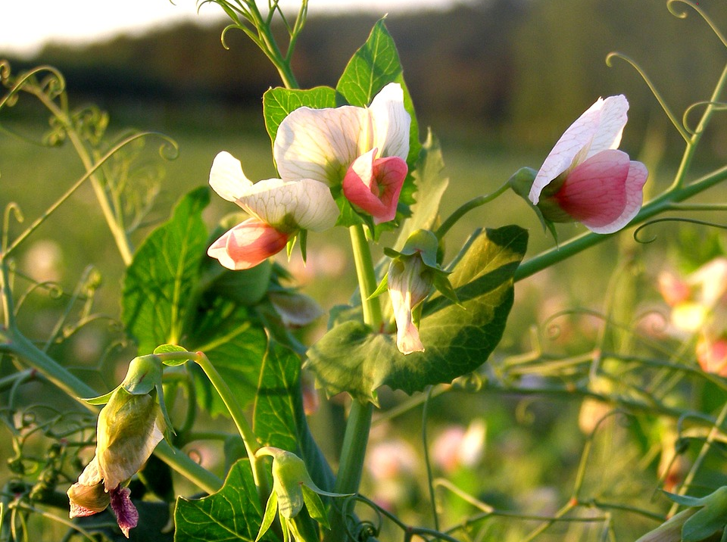
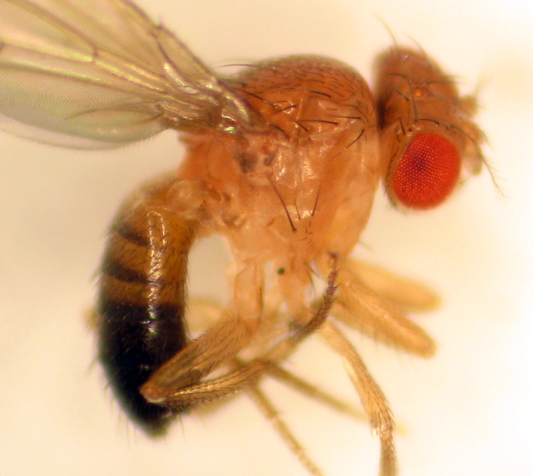
Many model organisms, such as mice, zebrafish, peas, and fruit flies, make the analysis of the inheritance of biological traits convenient.

Slide 4
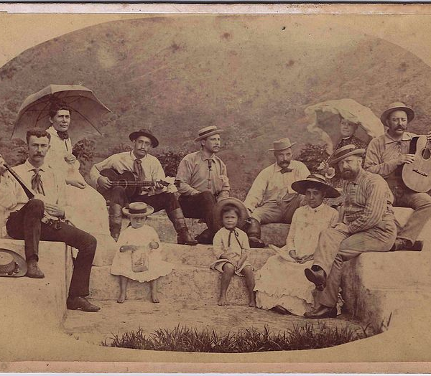
By contrast, due to various complications and ethical considerations, studying the inheritance of human traits is more challenging.

Slide 5
Objectives:
Understand the importance of pedigrees in studying inheritance in humans.
Construct and analyze pedigrees involving different genetic conditions in humans.

Slide 6

Studying Inheritance in Peas

Slide 7
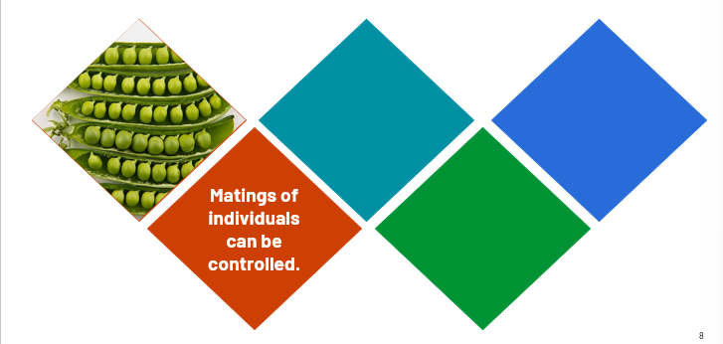
Studying Inheritance in Peas

Slide 8
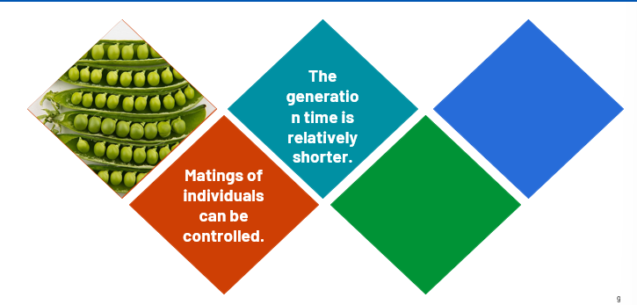
Studying Inheritance in Peas

Slide 9
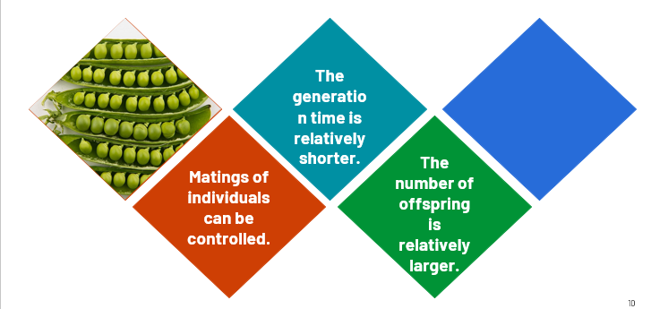
Studying Inheritance in Peas

Slide 10
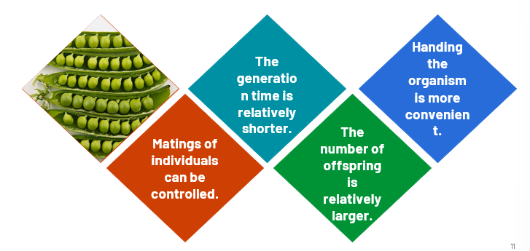
Studying Inheritance in Peas

Slide 11

Studying Inheritance in Humans

Slide 12
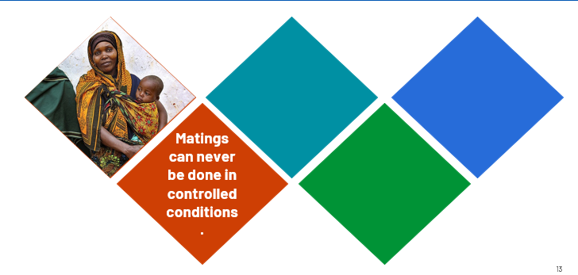
Studying Inheritance in Humans

Slide 13
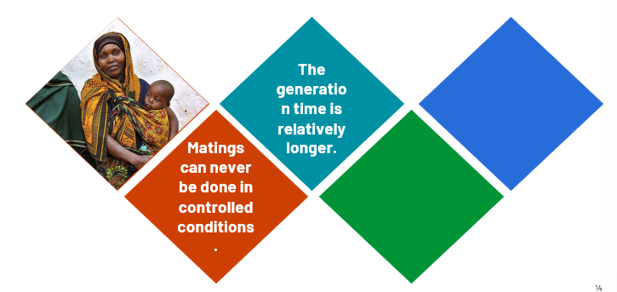
Studying Inheritance in Humans

Slide 14
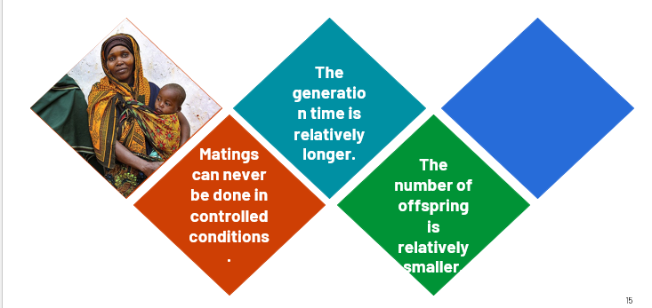
Studying Inheritance in Humans

Slide 15
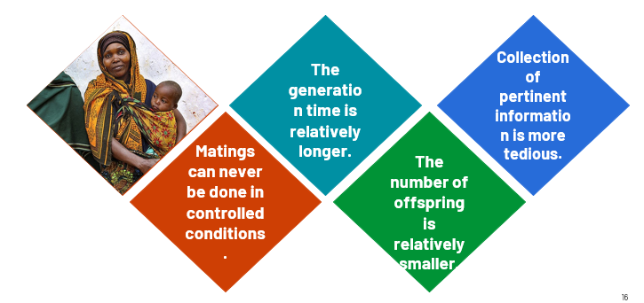
Studying Inheritance in Humans

Slide 16
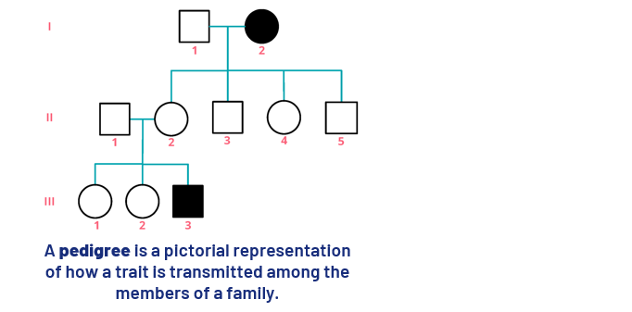
Using Pedigree

Slide 17
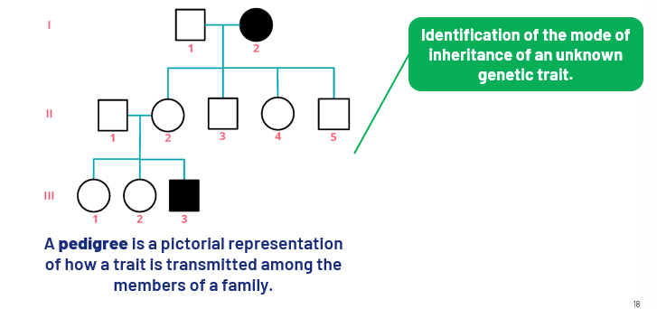
Using Pedigree

Slide 18
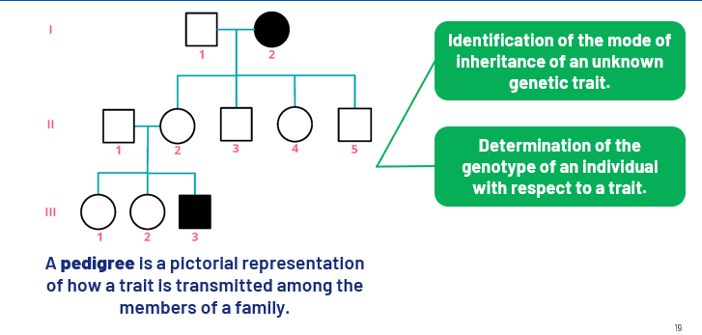
Using Pedigree

Slide 19
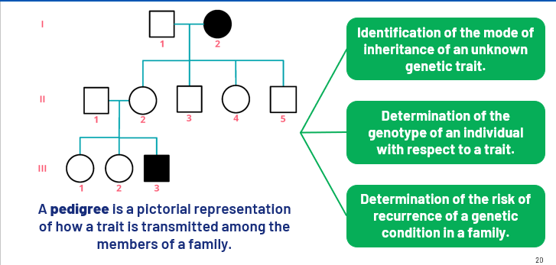
Using Pedigree

Slide 20
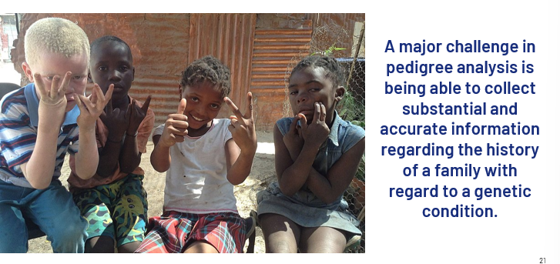
Challenges of Pedigree Analysis

Slide 21
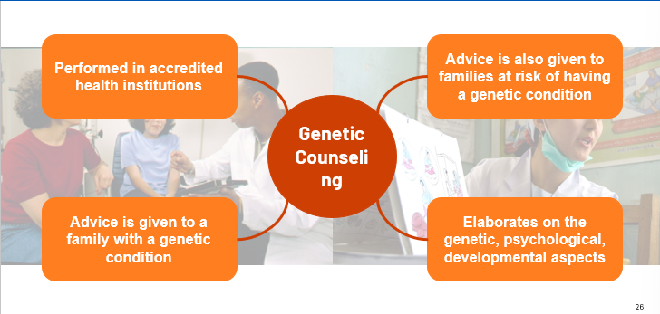
Pedigree Analysis in Genetic Counseling

Slide 22
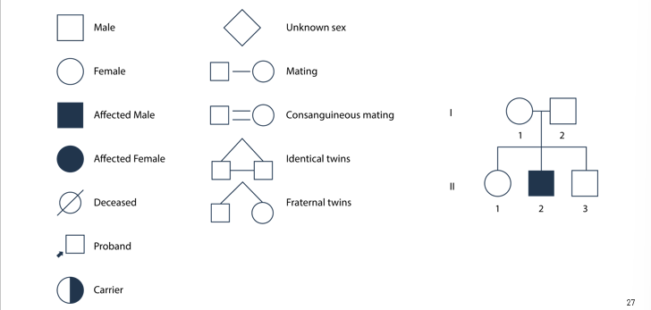
Constructing Pedigrees

Slide 23
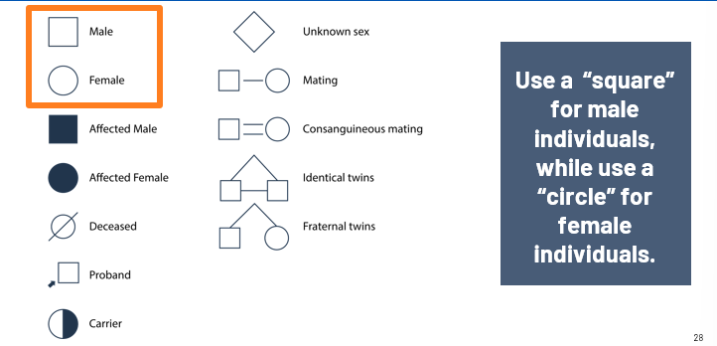
Constructing Pedigrees

Slide 24
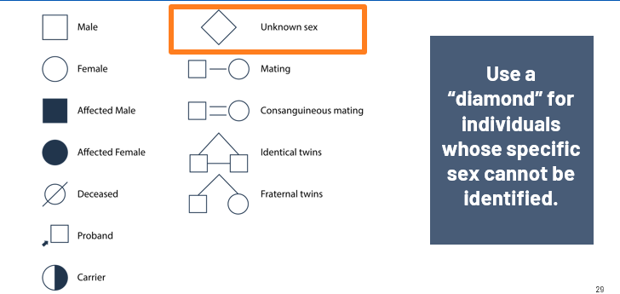
Constructing Pedigrees

Slide 25
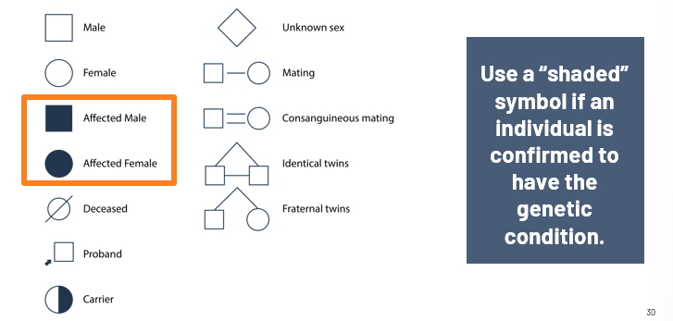
Constructing Pedigrees

Slide 26
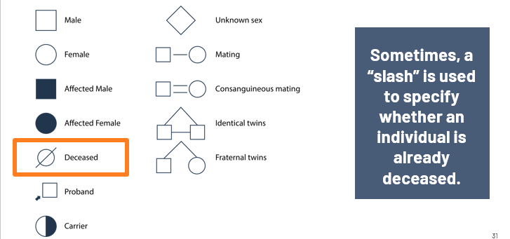
Constructing Pedigrees

Slide 27
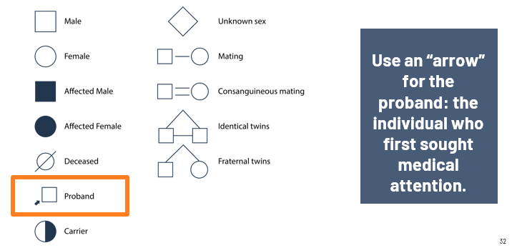
Constructing Pedigrees

Slide 28
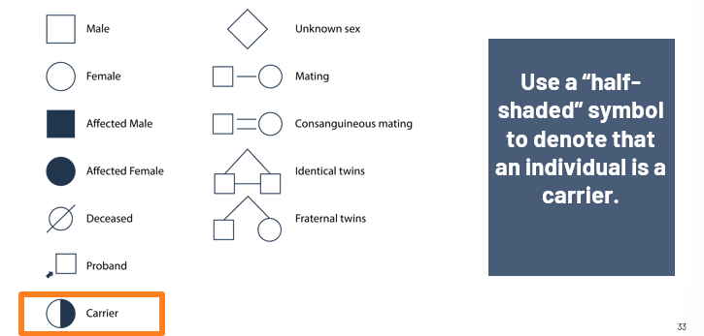
Constructing Pedigrees

Slide 29
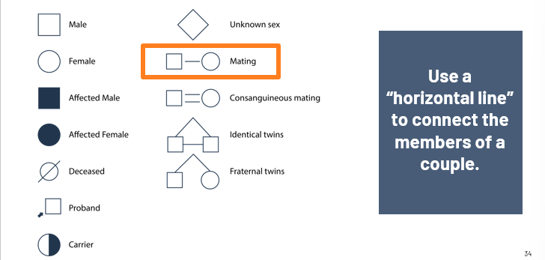
Constructing Pedigrees

Slide 30
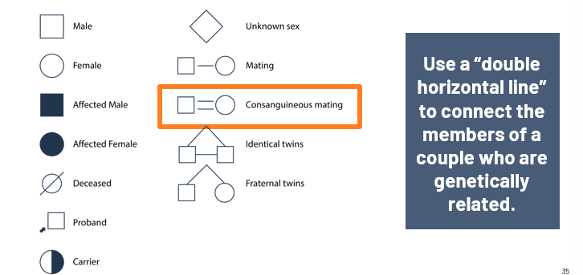
Constructing Pedigrees

Slide 31
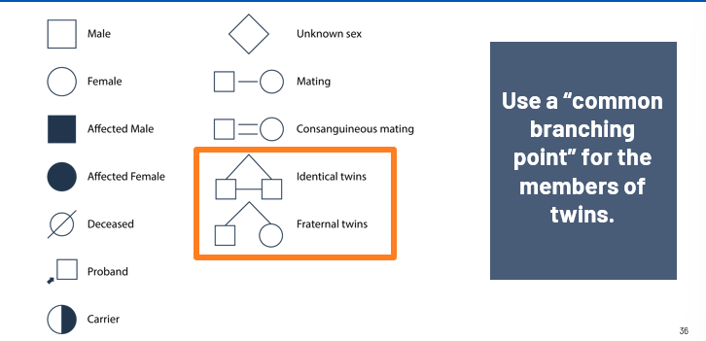
Constructing Pedigrees

Slide 32
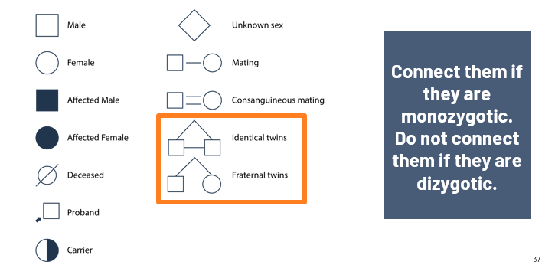
Constructing Pedigrees

Slide 33
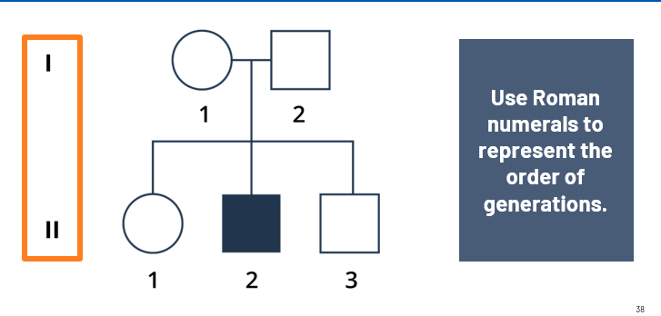
Constructing Pedigrees

Slide 34
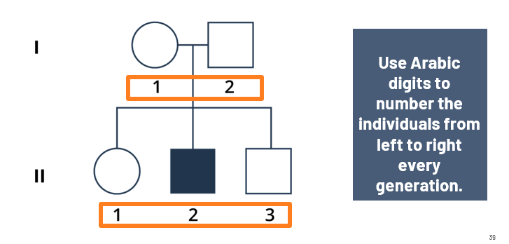
Constructing Pedigrees

Slide 35
In problems involving pedigree analysis, it is rare that the specific trait or characteristic is provided in the problem. This will somehow defeat the purpose of the analysis.

Slide 36
For example, we cannot specify that the trait involved is albinism because you are already familiar with its mode of inheritance, which is autosomal recessive. Also, the “half-shaded” symbol is not used to denote the carrier status of an individual. It is the purpose of the analysis to determine whether an individual is a carrier or not.

Slide 37
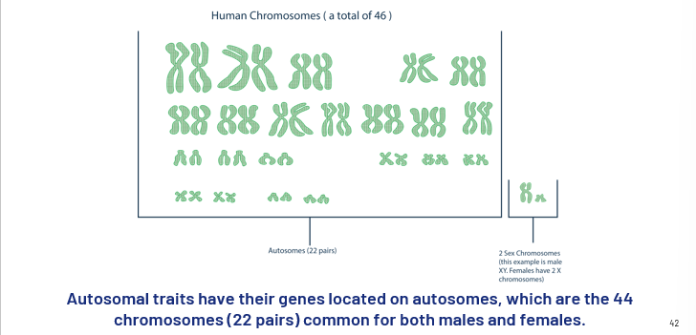
Autosomal Traits

Slide 38
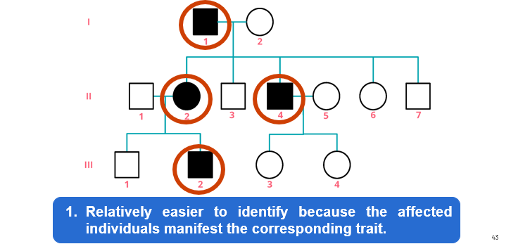
Autosomal Traits

Slide 39
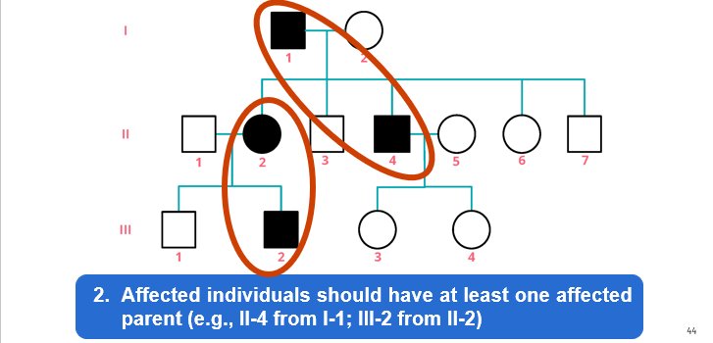
Autosomal Traits

Slide 40
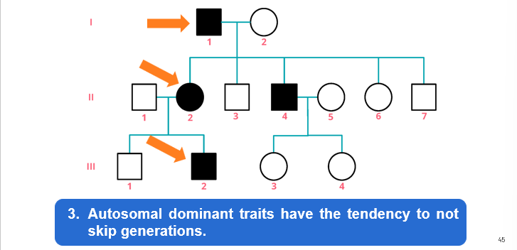
Autosomal Traits

Slide 41
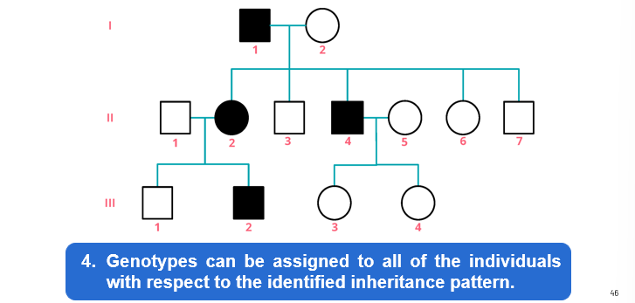
Autosomal Traits

Slide 42
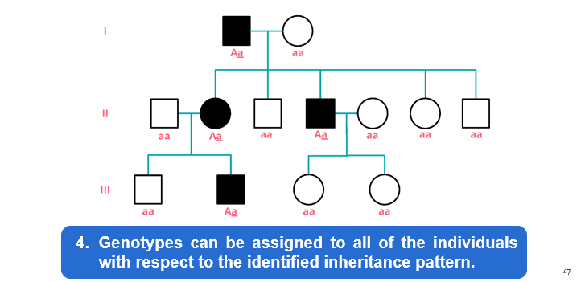
Autosomal Traits

Slide 43
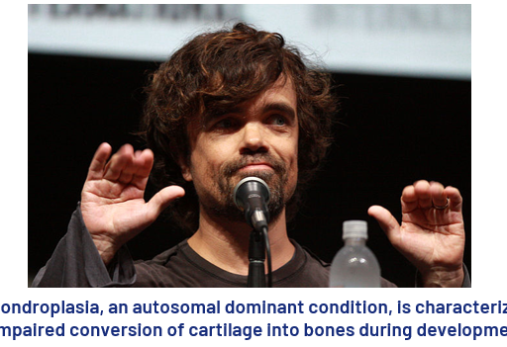
Autosomal Dominant Inheritance

Slide 44
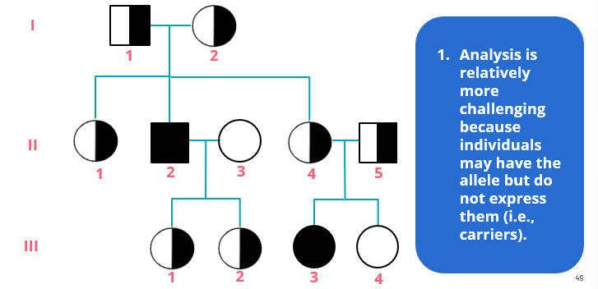
Autosomal Recessive Inheritance

Slide 45
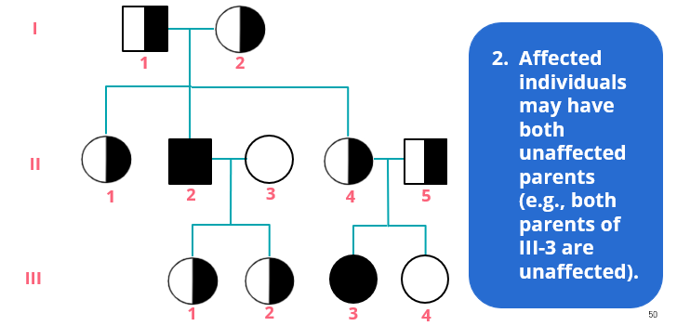
Autosomal Recessive Inheritance

Slide 46
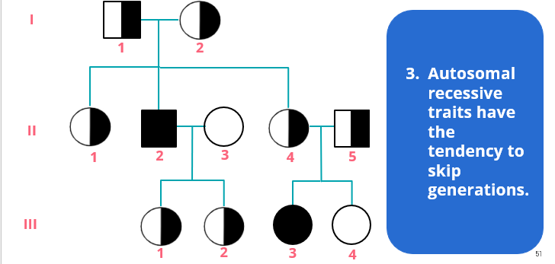
Autosomal Recessive Inheritance

Slide 47
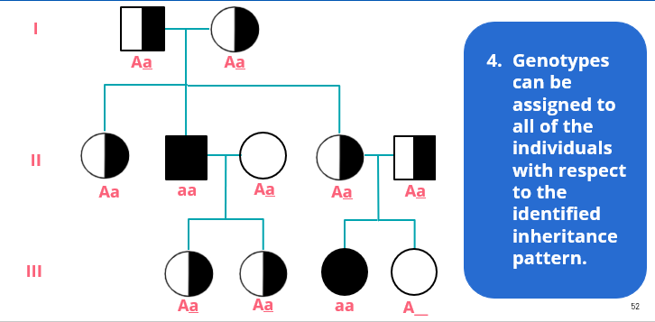
Autosomal Recessive Inheritance

Slide 48
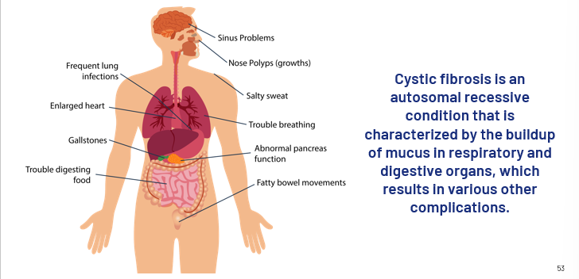
Autosomal Recessive Inheritance

Slide 49
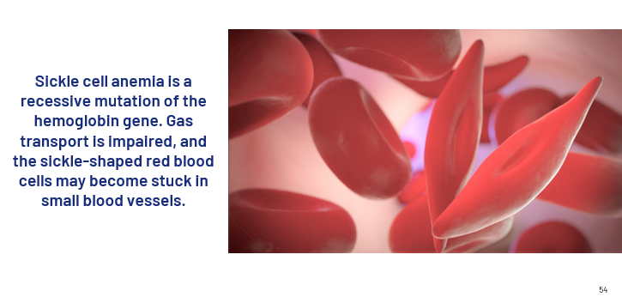
Autosomal Recessive Inheritance

Slide 50
How does consanguineous mating become disadvantageous to the members of the couple involved?

Slide 51
When analyzing pedigrees, and you are asked to provide the genotypes of the individuals, there may be cases when you can leave the second allele blank.

Slide 52
For example, an individual has a dominant phenotype, A__. However, due to insufficient information, one cannot determine whether the second allele is dominant or recessive. Thus, you may leave it as it is.

Slide 53
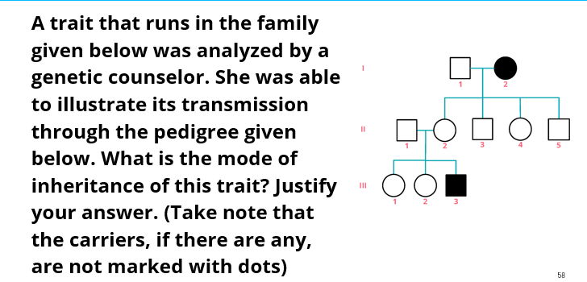
Example:

Slide 54
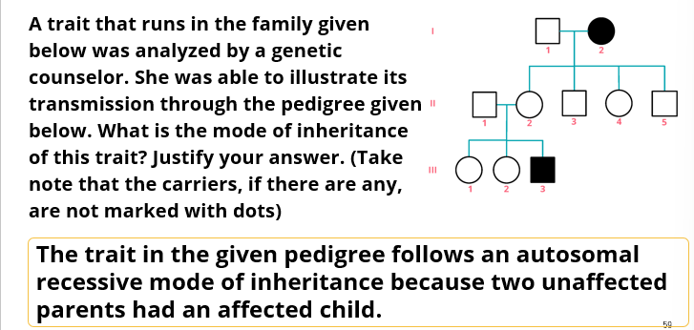
Example:

Slide 55
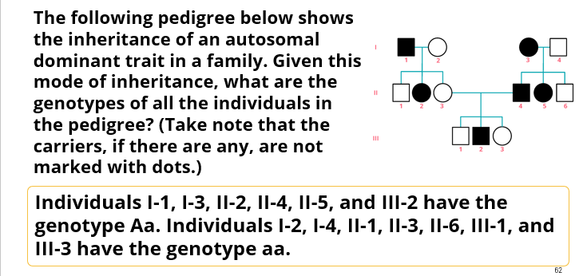
Example:

Slide 56
Example:
Agnes and Jerwin married. Their first child is a girl named Dorothy. She has two brothers named Mark and Raymond, respectively. Mark and Raymond have a genetic condition that causes them to have dark urine, which neither of their parents has. Later, Dorothy married Michael, who is unaffected, and they had three children. The first two children, a boy, and a girl, respectively, are normal. However, their third child, who is a boy, has the genetic condition that Mark and Raymond have.

Slide 57
Furthermore, Raymond married Melissa, who is unaffected. They have three children, the first two being boys, and the third one is a girl, all of whom are affected. Construct a pedigree for this family and determine the mode of inheritance of the genetic condition.

Slide 58
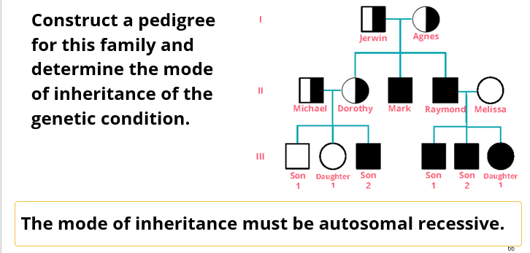

Slide 59
Assignment
Jane married Paul, who has a certain genetic condition that runs in his family. They had three children. Their first child, a boy named Marco, does not have the condition. However, their second and third children, Rica and Angela, both have the condition. Later, Angela married Dexter. They have five children, the first child being a girl named Roxi. The rest are boys, the last two being affected by the condition. Construct a pedigree of their family and analyze the mode of inheritance of the trait.

Slide 60


Slide 61
References
Brooker, J. Concepts of Genetics (1st ed.). New York, USA: McGraw-Hill Companies Inc., 2012.
Klug, W.S, and Cummings, M.R. Concepts of genetics (6th ed). Upper Saddle River, N.J: Prentice-Hall. 2003.
Pierce, B. Genetics: a conceptual approach (8th ed). New York: W.H. Freeman. 2012.
Reece J., Taylor M., Simon E., and Dickey J. Campbell Biology: Concepts and Connections (7th ed.). Boston: Benjamin Cummings/Pearson. 2011.
Snustad, D.P., and Simmons, M.J. Principles of Genetics (6th ed.). Hoboken, NJ: Wiley. 2012.

